Slide 1

IOT
SECURITY
~ Shankar Subramanian

Slide 2

WHAT IS IOT?
They are electronic devices hooked up to the internet
Have huge supply chains, with multiple product makers
and people creating the thing.
There are two different kinds of devices:
Frequent updates but short lifetime
Very rare updates but long lifetime

Slide 3
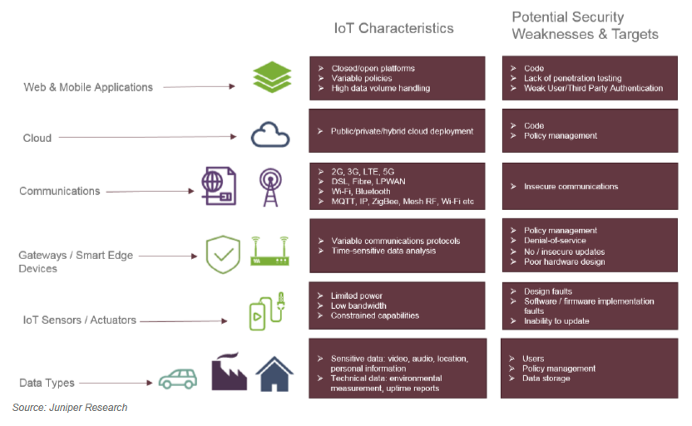

Slide 4
WHAT MAKES IOT DEVICES MORE VULNERABLE?
IOT devices are:
Pre packaged with barely any security
PCs come with firewalls, and anti-virus and random hardware memory allocations that improve the security
The primary reason behind manufacturers not taking these precautions is for them to be able to push out products at a faster and cheaper to beat their competitors.

Slide 5
TYPES OF IOT ATTACKS
IOT attacks are primarily of two types:
Software
Hardware
The requirements to develop or hack a system include:
The knowledge of an Embedded Systems engineer
Understanding of cyber security and ability to trace flaws
Understanding of the kernel that is used

Slide 6
TYPES OF IOT ATTACKS
IOT attacks are further divided as follows:
Software Attacks
Bug Finder
Web Server
Shell injections
Hardware Attacks
Non invasive
Side channel
Fully invasive

Slide 7
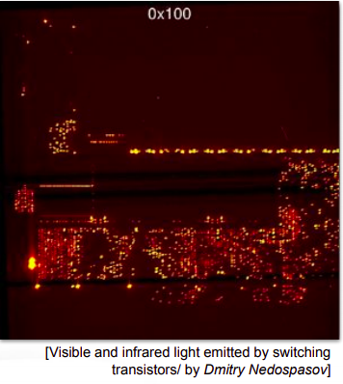
DIFFERENTIATION BETWEEN TYPES
Hardware attacks are less rare but are guaranteed attacks
Software attacks are rare but when started can flow for a long time and are hard to stop
However most of them are only theoretical, the real world attacks usually are:
UART
EMMCS
Injections

Slide 8
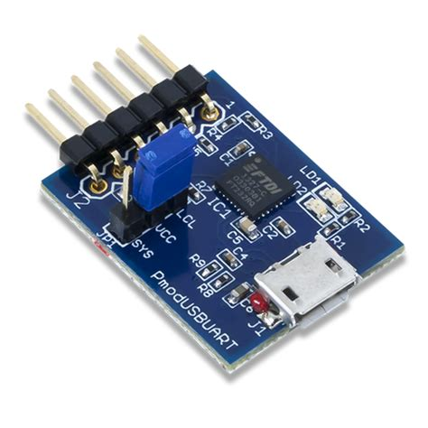
UART ATTACKS
They have 4 or 5 pins being Tx, Rx, VCC, GND
They may or may not be populated
Populated ones are easier for the hacker
Things to look for while hacking:
Well formatted data coming out like a menu driven option
U-boot being accessible to prevent bootloaders being changed
Shell injections like init=/bin/sh
Shorting NAND pins 29 and 30
Bruteforcing and other shell injections

Slide 9
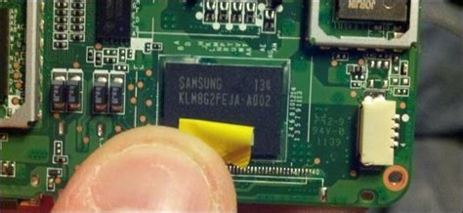
EMMC ATTACKS
On board soldered chips that contain data
Do not contain bit and parity checks
Can be read with a EMMC reader
Direct contact with storage
Things to look for while hacking:
Modifying the storage files and the OS permissions
Installing stuff like SuperSu
Replacing the sys.fs file

Slide 10
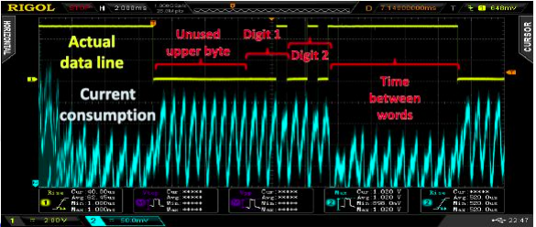
SOFTWARE ATTACKS
Man in the middle
Poorly designed software
Side channel hits

Slide 11
SHELL INJECTIONS
Developers use code like system(“ls %s”) and then pass in ‘s’ as a variable
This enables the hackers to execute code in these by using the semicolon ‘;’
An example would be ;reboot; and now the linux system would execute a reboot
Things to look out for while hacking:
Supported web pages on the IOT where you can SQL and Shell inject
Old protocols like FTP and telnet
Unpatched or un reduced kernel files
Bruteforce on a dictionary

Slide 12
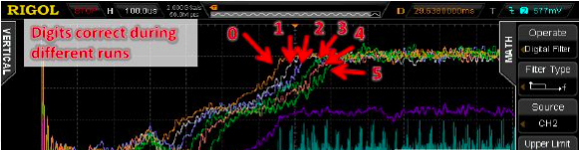
REAL-LIFE EXAMPLES OF BAD SOFTWARE DESIGN
Saving data on EEPROM
Encoding instead of Encrypting
Not disabling telnet, ftp, other old protocols
Not using hop frequency keys on bluetooth

Slide 13
REAL WORLD ISSUES
Mirai - based on the fact that people didn’t change the default credentials. DDOS on Twitter, Facebook, MakeMyTrip, and many more
PewDiePie vs T-Series - printers and home security cameras were hacked
Ransomware - ransomware attacks on cars is a future possibility
Cayla - a baby monitoring doll that can be connected to by anyone, banned in several European countries

Slide 14
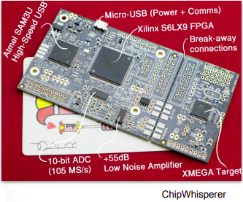
TOOLS THAT CAN BE USED
Hardware:
JTAG
USB
SDR
Software:
Binary Reversing
Bug Finder
Firmware Analysis

Slide 15
PSA SECURITY STANDARD
Unique Identification
Security Lifecycle
Attestation
Secure boot
Security Update
Anti-rollback
Isolation
Interaction
Secure Storage
Cryptography/trusted service

Slide 16
SOFTWARE IMPLEMENTATION
Closing backdoors
Encryption
Use safer functions for buffer management like fgets() over gets()
Run in constant time to prevent timer based attacks
Add commands to the allowlist instead of blocklist
Don’t let user execute system() commands
Don’t hardcode secrets and prevent rollbacks
Test SQL injections, XSS, Shell injections
Remove/Disable unused features
Connect IOT devices on a seperate network and make each device have a different password

Slide 17
SOURCES
ARM
TEDxTalks
PSAcertified
gtvhackers
Android authority
Computerphile

